Slide 1


Johnson-Nyquist noise hardware random number generator FOR SERVER LOAD BALANCERS
SREYAS KISHORE
MUHAMMED MIDLAJ
MOHAMMED SUHAIL
VAISHNAV U
Guide: Prof. Jinu Jayachandran

Slide 2
Random number generator for server load balancer
A random number generator for a server load balancer generate numbers within a specified range to distribute incoming requests evenly across available servers.
Modern load balancers usually use algorithms like Round-Robin, Least Connections, or Hash-Based Routing to distribute traffic. However, these approaches have limitations that create a need for a Random Number Generator (RNG)-based load balancing method.

Slide 3
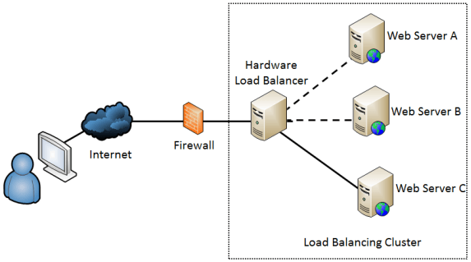
CONVENTIONAL Server Load Balancers

Slide 4
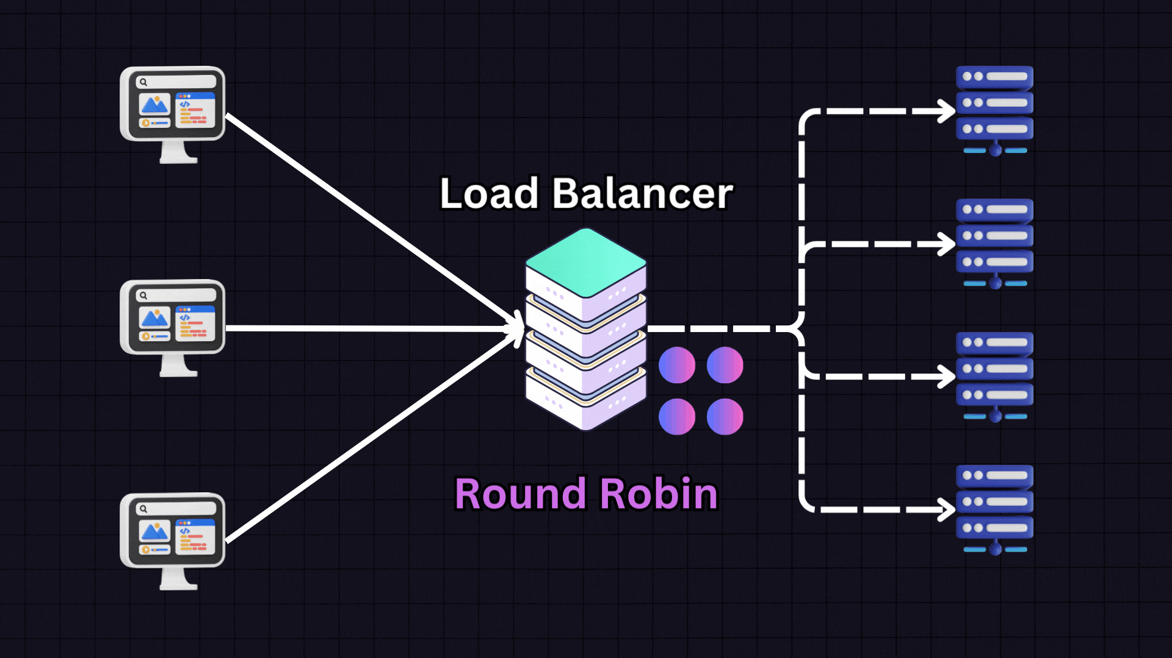
TRADITIONAL LOAD BALANCING USING ROUND ROBIN

Slide 5
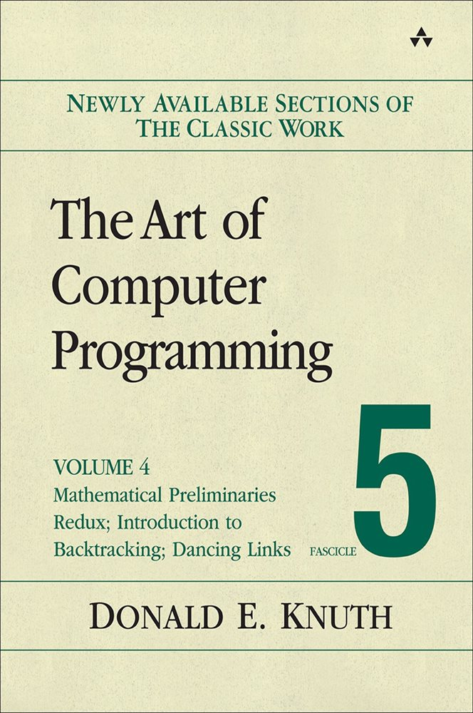
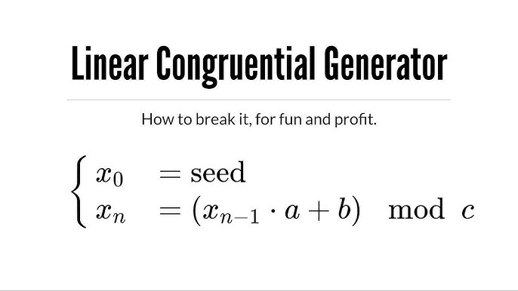
COMPUTERS USES PSEUDO-RANDOM NUMBER GENERATOR ALGORITHMS LIKE LCG (LINEAR CONGRUENTIAL GENERATORS)

Slide 6
problem WE INTEND TO solve
Computers primarily use pseudo-random number generator (PRNG) algorithms, such as Linear Congruential Generators (LCG), which are inherently predictable due to their deterministic nature. This predictability poses a major security risk in cryptographic applications and other areas where true randomness is highly required.
Key issues:
Predictability in PRNGs makes them susceptible to attacks and compromises security.
Lack of true entropy sources in conventional computing limits randomness quality.
Bias and periodicity in PRNGs lead to non-uniform distributions, reducing reliability.
To overcome this limitation in security, our project explores Johnson Noise as a high-entropy source for generating truly random numbers.

Slide 7
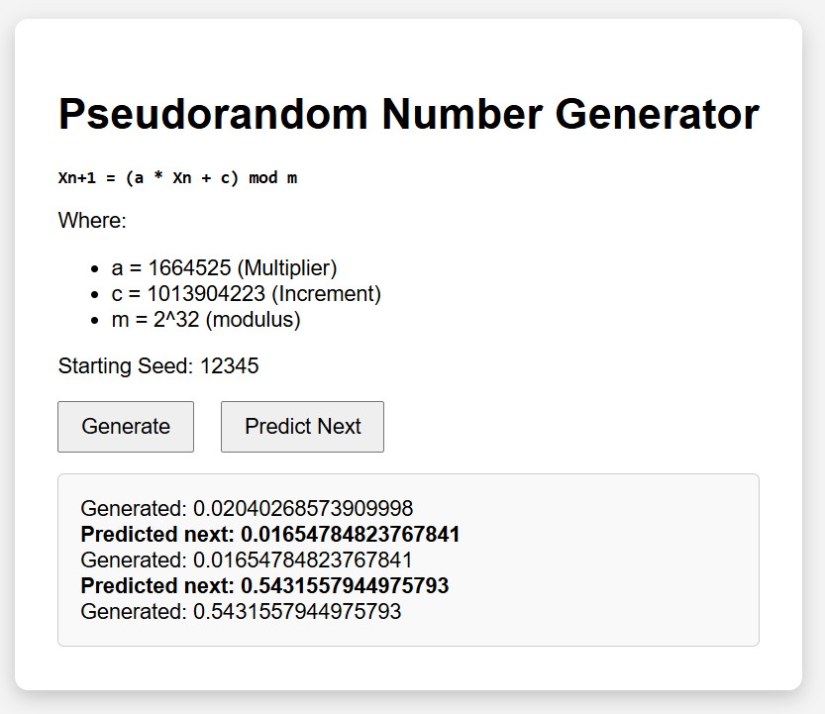
THE RISK OF PREDICTABILITY
What if random OTPs sent by our banks become predictable !?

Slide 8
Johnson-Nyquist Noise ! A true rng. :
Johnson noise is generated by the random motion of charge carriers (electrons) in a conductor due to thermal energy.
At any temperature above absolute zero (0 K), electrons in a conductor move randomly due to thermal energy.
These random electron movements cause tiny, unpredictable voltage fluctuations across the conductor.
Since the motion is chaotic and independent, the noise is completely random.

Slide 9
AC sinusoidal
Voltage Source
Wheatstone Bridge
Instrumentation Amplifier
Zener Diode
Microcontroller
USB-UART CONVERTER
RNG and then transmit via UART
Post Processing
Analog-to-Digital Converters (ADC)
Communicates with Jupyter Notebook via PySerial
Server Load Balancer

Slide 10
BUT, HOW TO GET JOHNSON NOISE ?
INSTRUMENTATION AMPLIFIERS !
Instrumentation amplifiers are specialized circuits designed to accurately amplify small differential signals while rejecting interference common to both inputs.
Since Johnson noise (thermal noise) is generated by resistors, the resistors from the Wheatstone bridge circuit, will each contribute their own Johnson noise.
The total noise appearing at the output of the bridge depends on the individual resistor noises and how they combine in the circuit.

Slide 11
The output voltage is taken from the middle points of the bridge
If the bridge is balanced (R1/R2=R3/R4), the DC output voltage is zero, but Johnson noise will still be present.

Slide 12
POST PROCESSING THE RAW NOISE
Since raw noise signals may contain biases, correlations, or unwanted artifacts, post-processing helps refine the randomness
The raw digital data from the ADC may have uneven distributions. Whitening can be done to ensure a uniform distribution

Slide 13
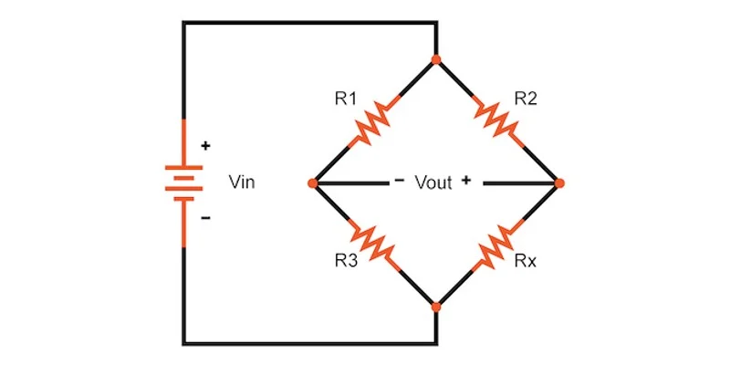
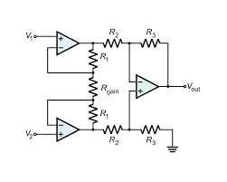
Experiment setup
BALANCED WHEATSTONE BRIDGE
When the bridge is balanced, no current flows through the galvanometer — meaning the voltage across it is zero.
Instrumentation Amplifiers

Slide 14
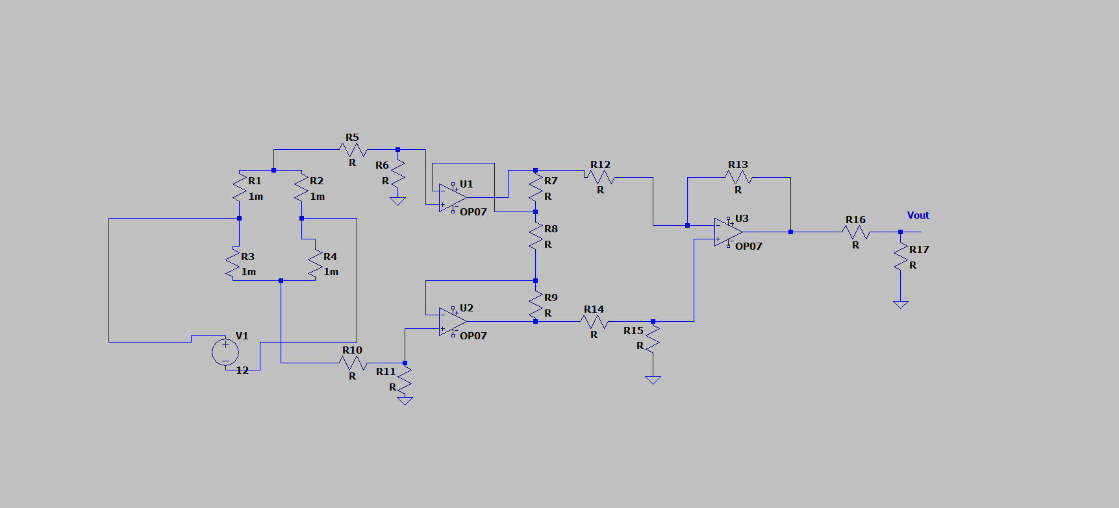

Slide 15
Analog to digital converters
ADC converts analog signals to its equivalent digital signals.
We used an Arduino for converting analog input signals to its equivalent digital format and then transmitted it into a computer.

Slide 16
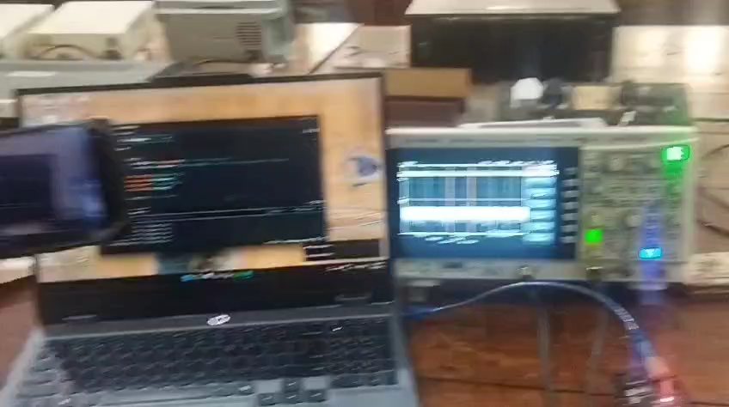
EXPERIMENT

Slide 17
OBSERVATIONS
Johnson Noise Magnitude= 20 microvolt (approximate)
First Stage Gain required= 500
FFT Showed a Broad spectrum (indicating White noise with constant Power Spectral Density)
FFT had an unexpected peak at lower frequencies (indicating the presence of a DC Offset voltage)

Slide 18
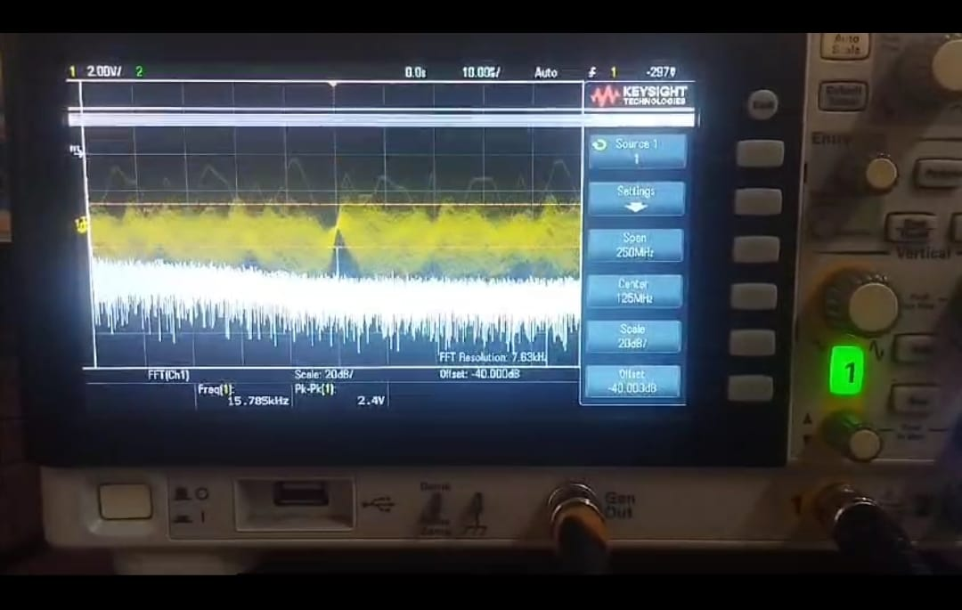
Challenge No.1 –DC Offset
We tried again removing the DC Offset

Slide 19
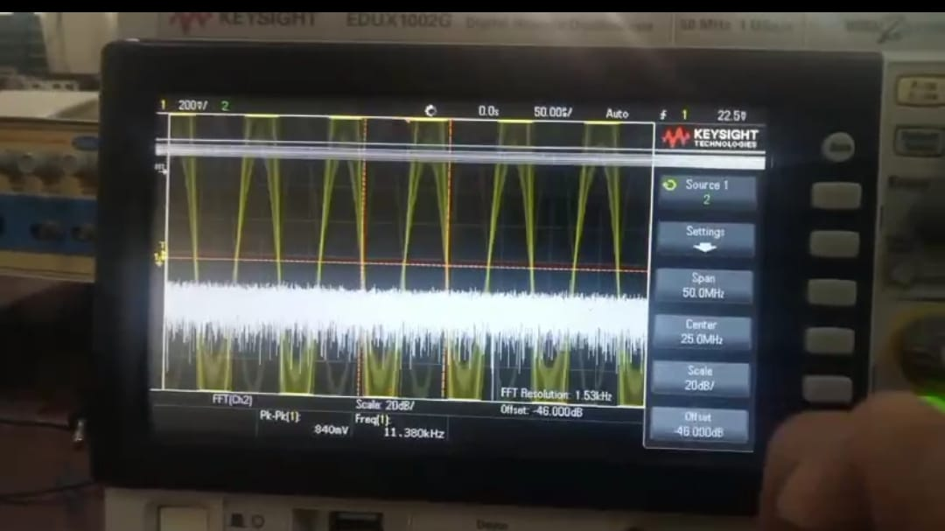
Problem Solved !
We replaced OpAmp 741 with Op07 to find the absence of unwanted DC Offset. And now the Fast Fourier Transform looks evenly spread out- indicating the presence of Johnson Noise.

Slide 20
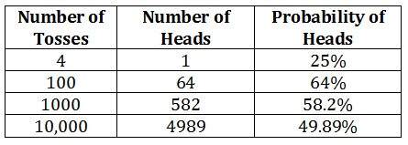
WHY RANDOM SCHEDULING FOR LOAD BALANCING !? Law of Large Numbers
if you repeat an experiment many times, the average result you get will become increasingly closer to the expected theoretical average, as the number of trials grows larger

Slide 21
Challenge no.2 – Unexpected output voltage levels
The output voltage changed chaotically as expected, but the voltage levels sometimes fluctuated between unreasonable voltage levels (upto 20V)
Unexpected voltage levels as high as 20V could destroy our ADC and Microcontroller, so we had to make a protection circuit using Zener Diode of 5.6V

Slide 22
microcontrollers
First the Arduino microcontroller was used for the post processing techniques (XOR-ing) and the result was sent to the computer via serial

Slide 23
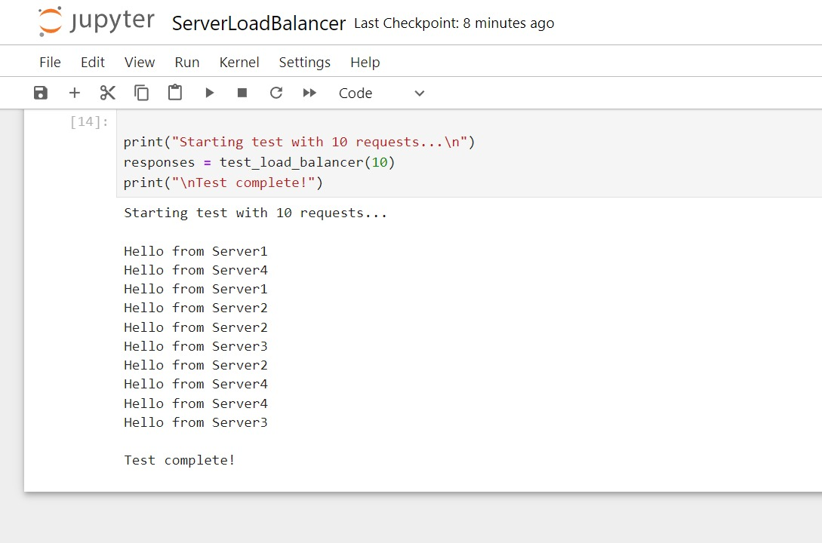
OUTPUT- SOFTWARE
The server traffic is getting balanced efficiently

Slide 24
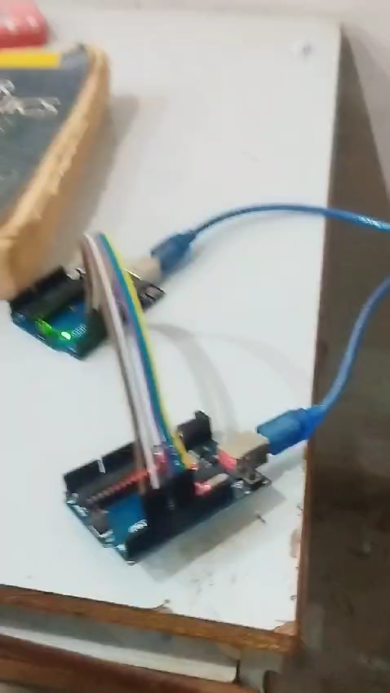
OUTPUT AFTER HARDWARE- SOFTWARE INTEGRATION

Slide 25
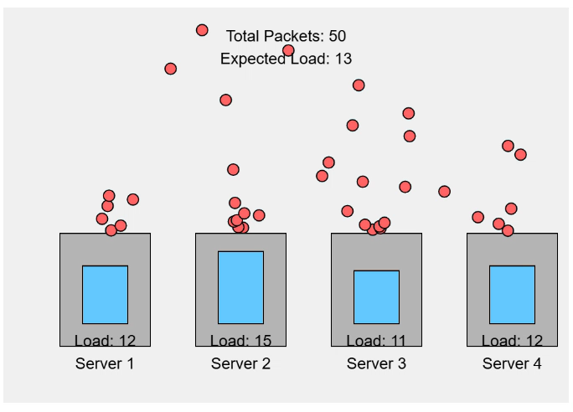

Slide 26
Planning and execution
ANALOG PART | MIDLAJ & VAISHNAV
MICROCONTROLLER PART | SREYAS
SOFTWARE | SUHAIL
RESEARCH & DOCUMENTATION | VAISHNAV, SUHAIL, MIDLAJ & SREYAS

Slide 27
After transmitting the required Random Numbers to the computer, the Jupyter Notebook can access them using PySerial Library.
Jupyter Notebook can be used to handle the Application side
Applications of the project other than Server Load Balancers:-
OTP Generation
Cryptography (Seeding)
Blockchain (Nonces)
Stochastic Market Model Simulation
Animation (Creating random worlds)

Slide 28
References
LINEAR INTEGRATED CIRCUITS, ROY CHOUDHARY
Alldatasheets.com
Modern Digital Signal Processing, Prabhakar Naidu
Random Signal Detection, Sam Shanmugan
Operational Amplifiers and Linear ICs, David A Bell

Slide 29
THANK YOU

Slide 30
WE ARE OPEN TO QUESTIONS

